Slide 1
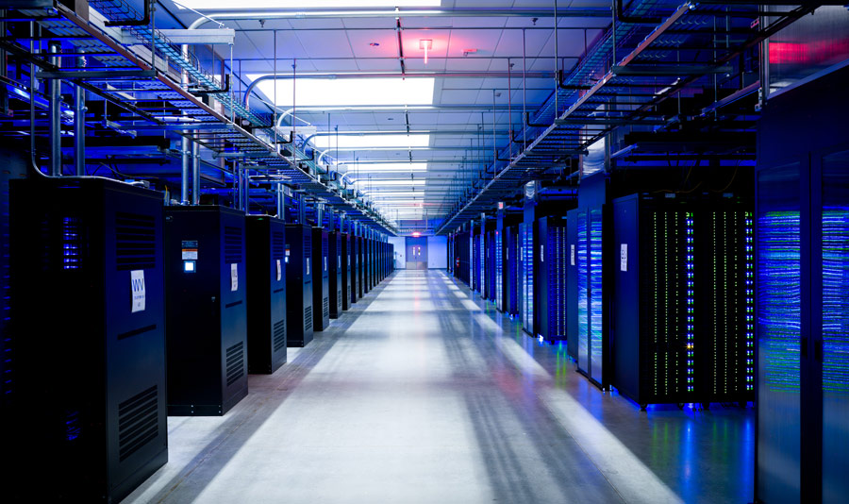
Security in the Cloud

Slide 2
Outline
Core security concepts
Attacks and Counter-Measures
Cryptographic tools
Run-Time Security
Counter-measures in the cloud
Many slides from L.Bouganim (INRIA)
and J.Gonzalez (CNEX Labs)

Slide 3
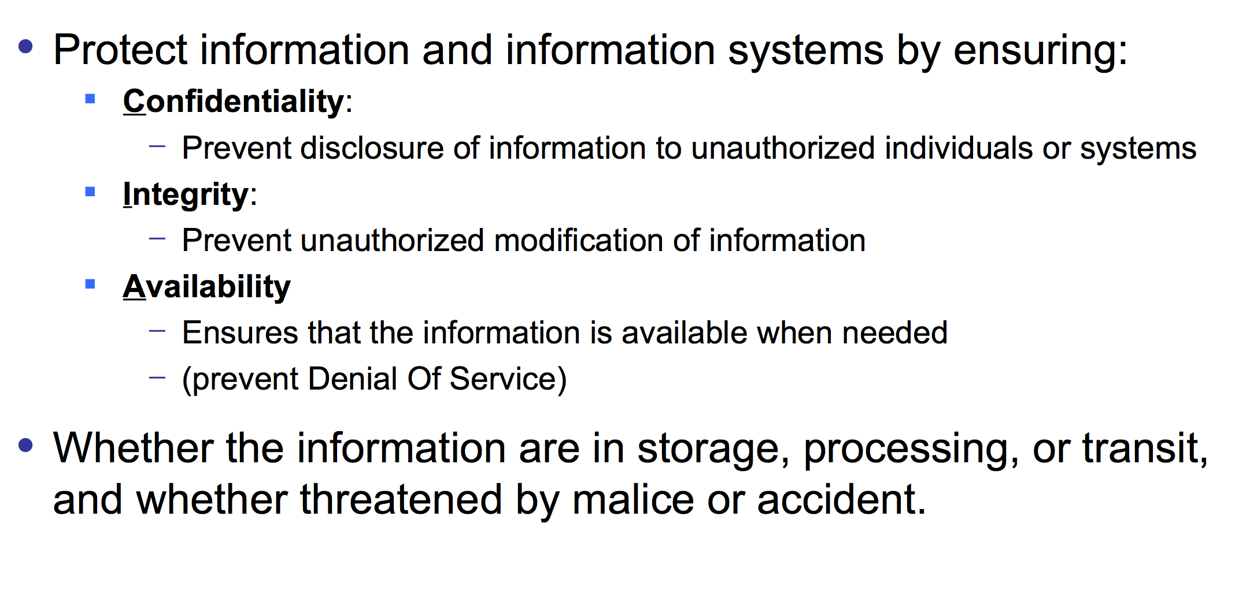
C.I.A
Courtesy of L.Bouganim

Slide 4
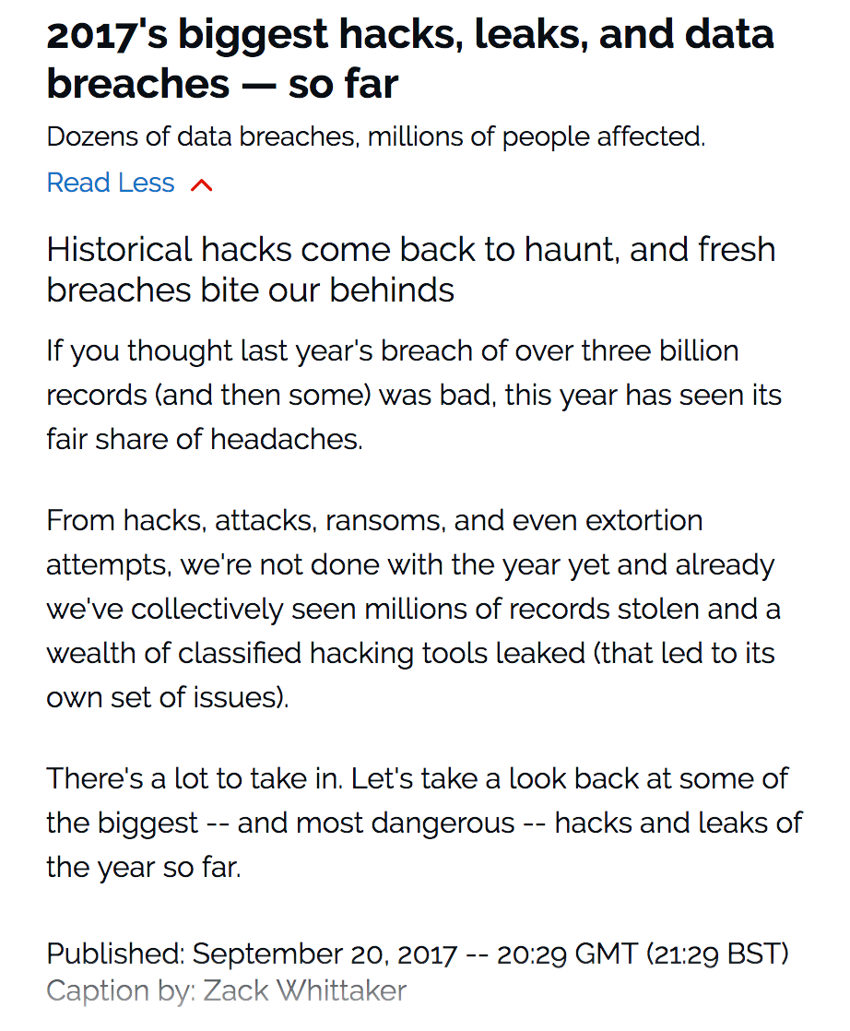
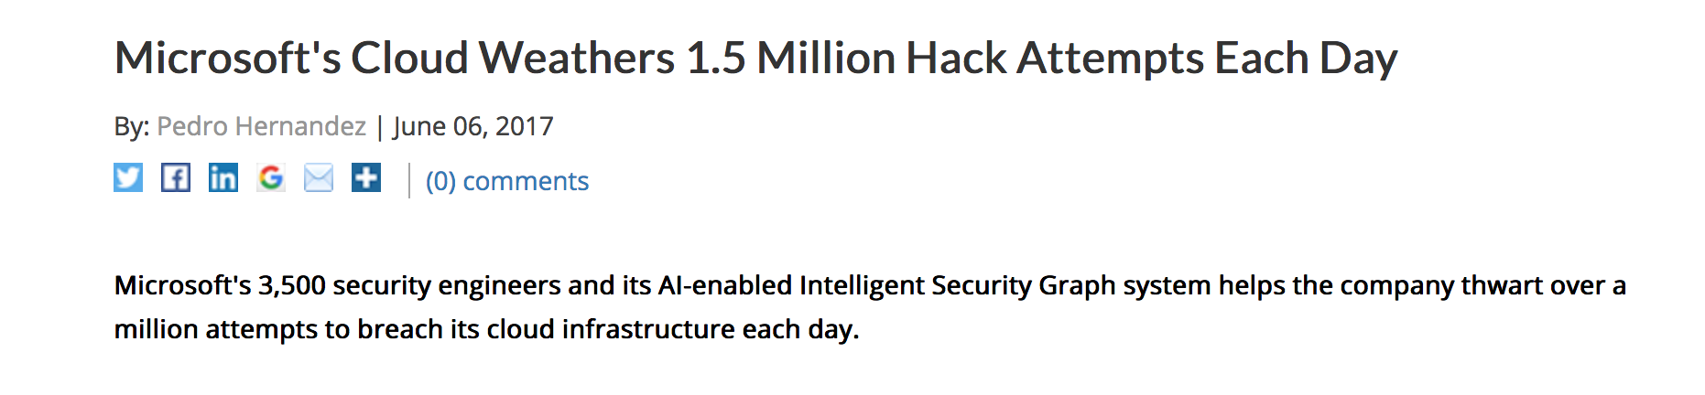
Security Problems?
http://www.zdnet.com/pictures/biggest-hacks-leaks-and-data-breaches-2017/
http://www.eweek.com/security/microsoft-s-cloud-weathers-1.5-million-hack-attempts-each-day

Slide 5
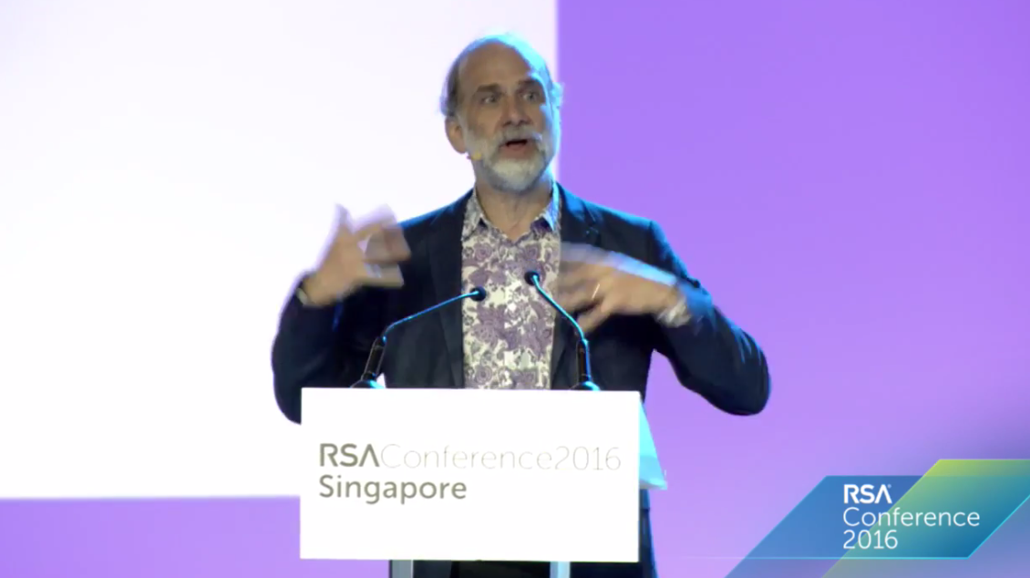
Bruce Schneier
https://www.schneier.com/
Security in the World-Sized Web
(05:30-07:53)

Slide 6
Security as an Arm’s Race
Shift in power balance
(1) powerless, the quick and nimble => technology as power equalizer (2) powerful, the strong => more raw power to leverage.
Attackers have advantage over defenders
Defend a surface vs. attack a point => Delay between new attacks and adequate defense
The quick are getting stronger
=> Cloud-based solutions enable large scale attacks.
=> Need for resilient security – security measures that resist attacks: redundancy, defense in depth, compartementalisation

Slide 7
Colliding Paradigms
Paradigm A: dangerous things => certifications (do it well the first time). If things break people die
Paradigm B: throw it out there and fix it quickly; be agile => patch Tuesday, automatic updates.
These two paradigms are colliding.
Need for homogeneous/timely regulation
High water-mark for computerization and connectivity. More conscious decisions about what to connect and how.

Slide 8
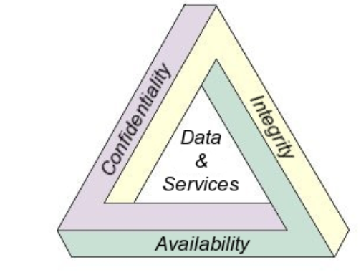
C.I.A
Courtesy of L.Bouganim

Slide 9
Outline
Core security concepts
Attacks and Counter-Measures
Cryptographic tools
Run-Time Security
Counter-measures in the cloud

Slide 10
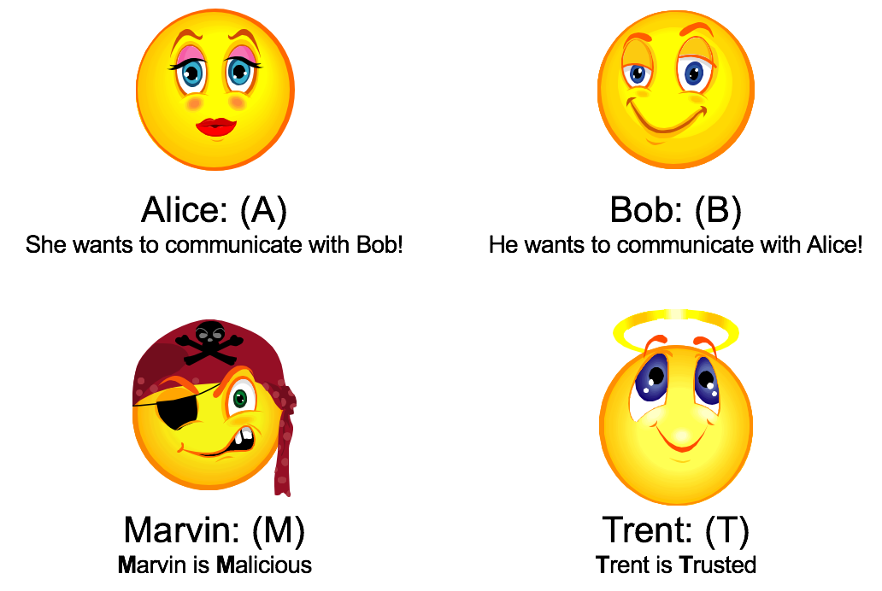
The Characters
Courtesy of L.Bouganim

Slide 11
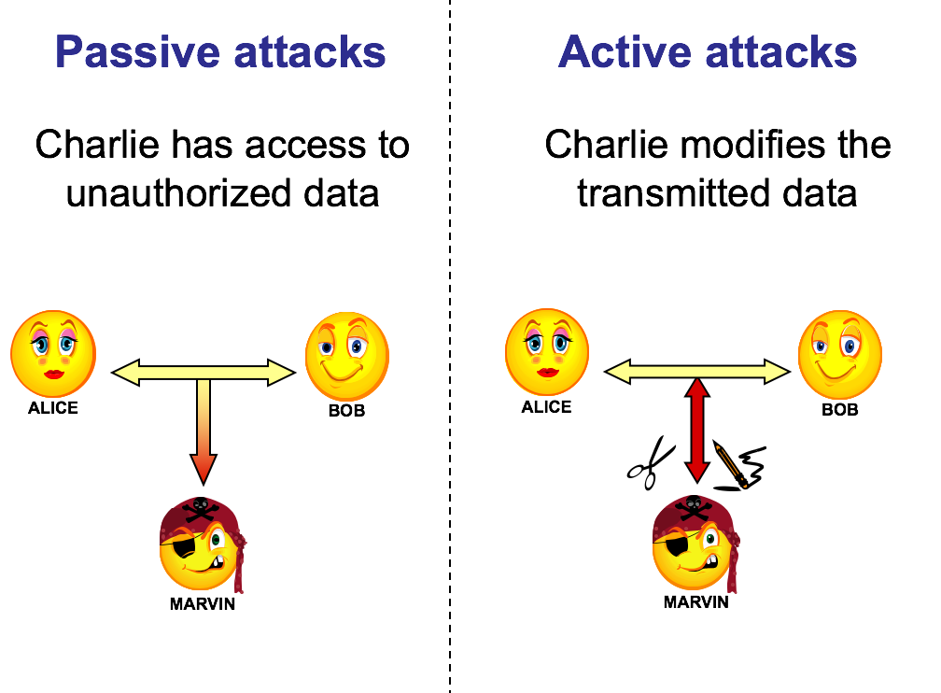
Passive/Active Attacks
Courtesy of L.Bouganim

Slide 12
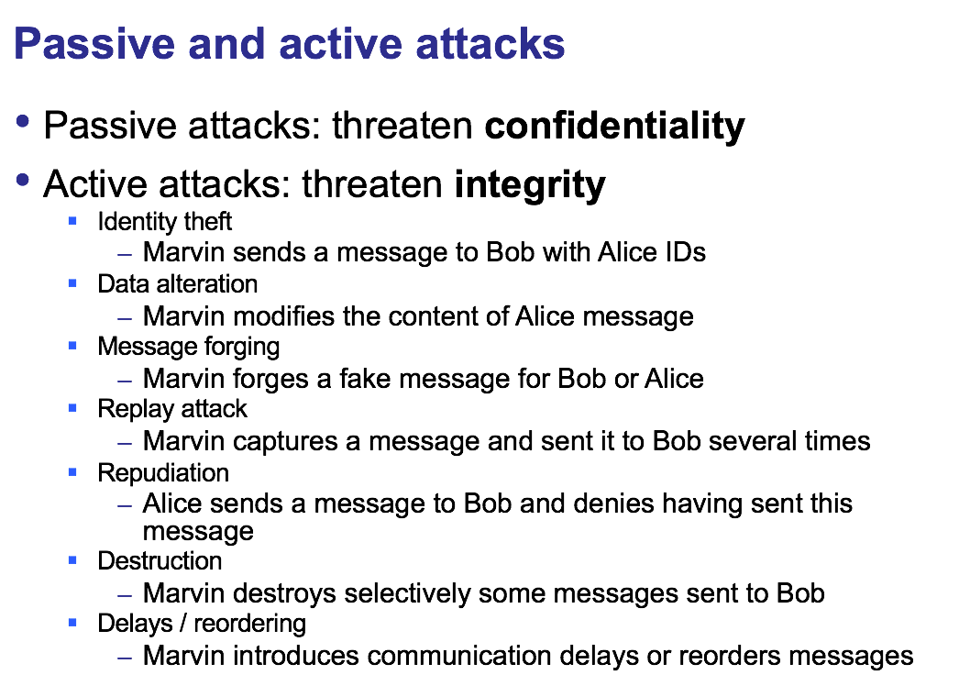
Passive/Active Attacks
Courtesy of L.Bouganim

Slide 13
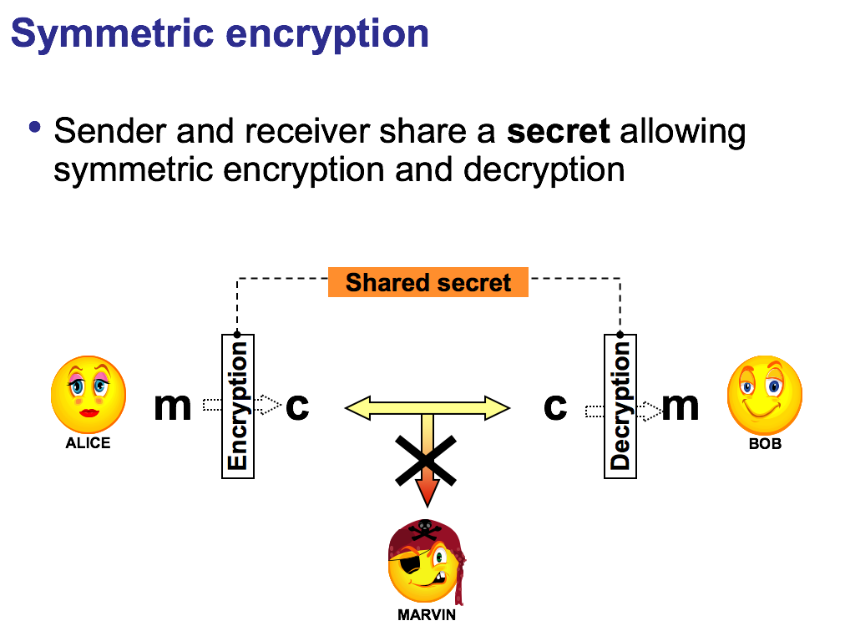
Symmetric Encryption
Courtesy of L.Bouganim

Slide 14
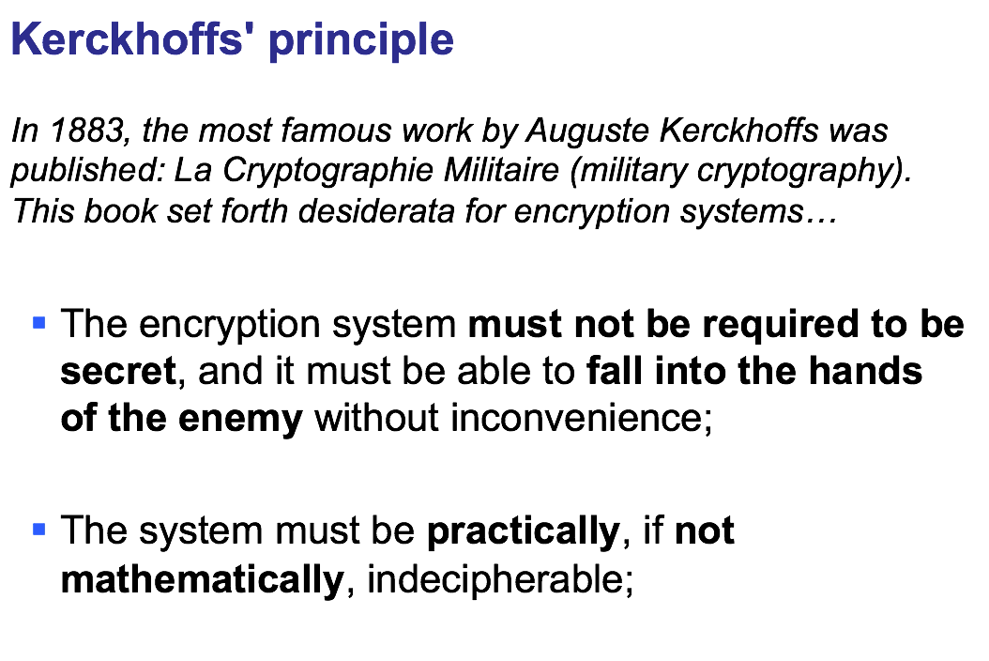
Symmetric Encryption
Courtesy of L.Bouganim

Slide 15
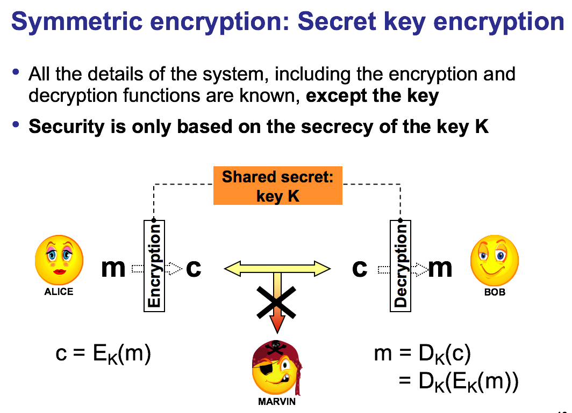
Symmetric Encryption
Courtesy of L.Bouganim

Slide 16
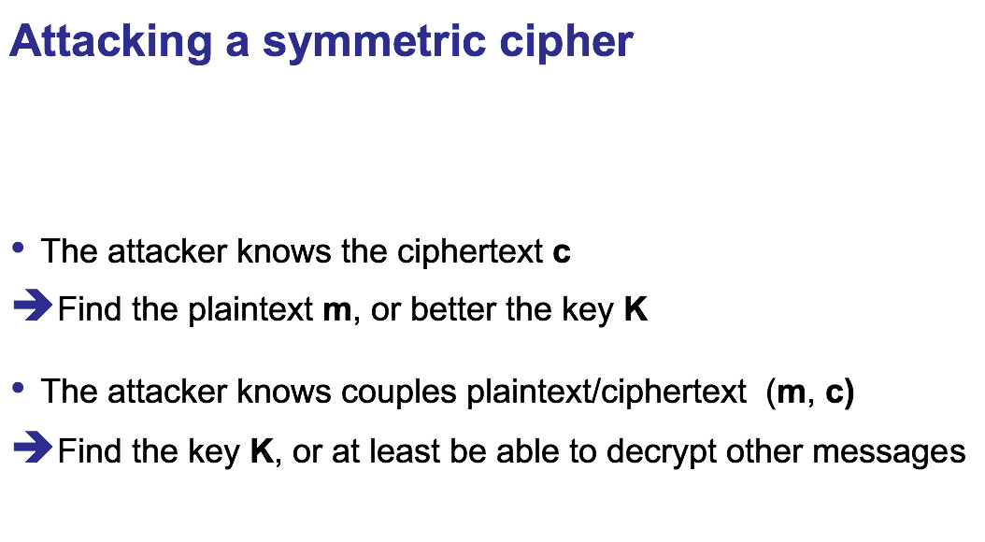
Symmetric Encryption
Courtesy of L.Bouganim

Slide 17
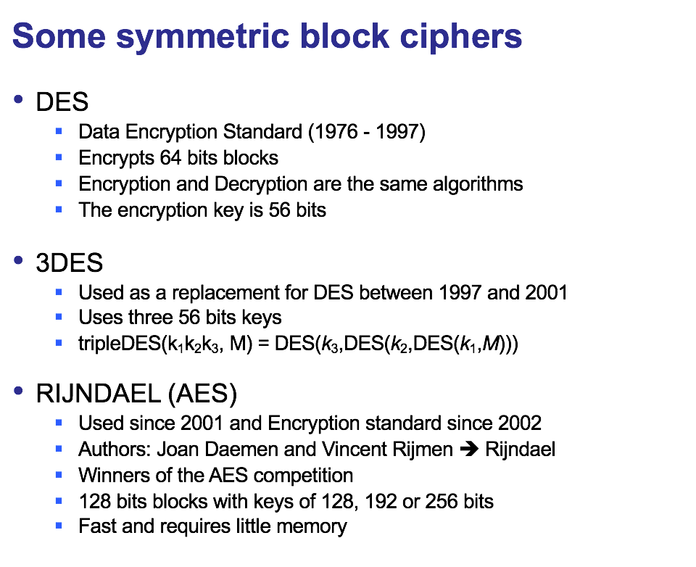
Symmetric Encryption
Courtesy of L.Bouganim

Slide 18
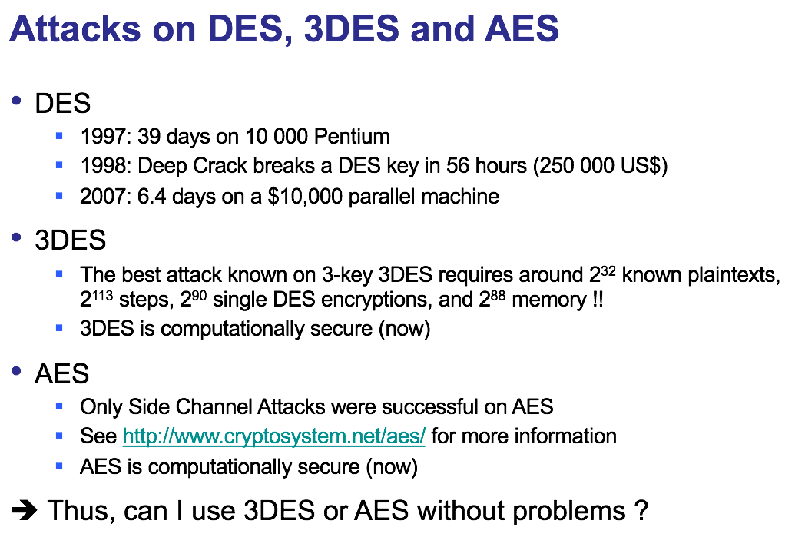
Symmetric Encryption
Courtesy of L.Bouganim

Slide 19
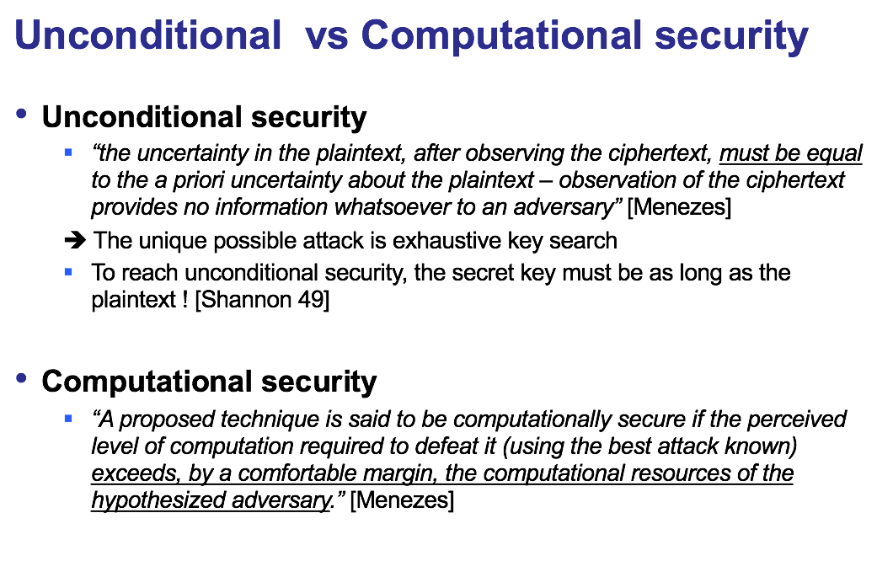
Symmetric Encryption
Courtesy of L.Bouganim

Slide 20
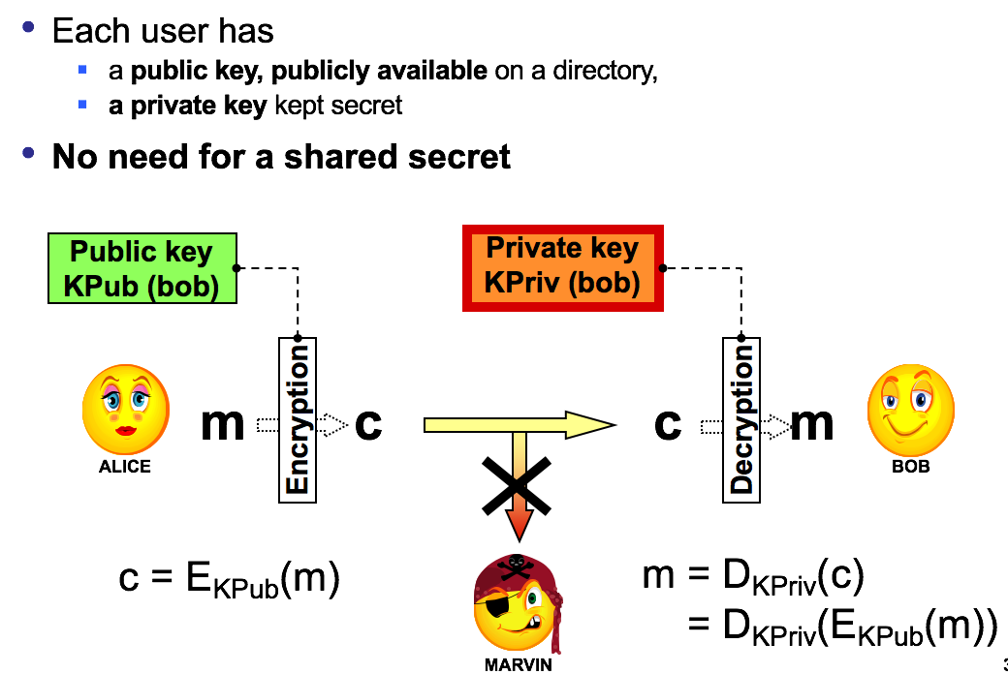
Asymmetric Encryption
Courtesy of L.Bouganim

Slide 21
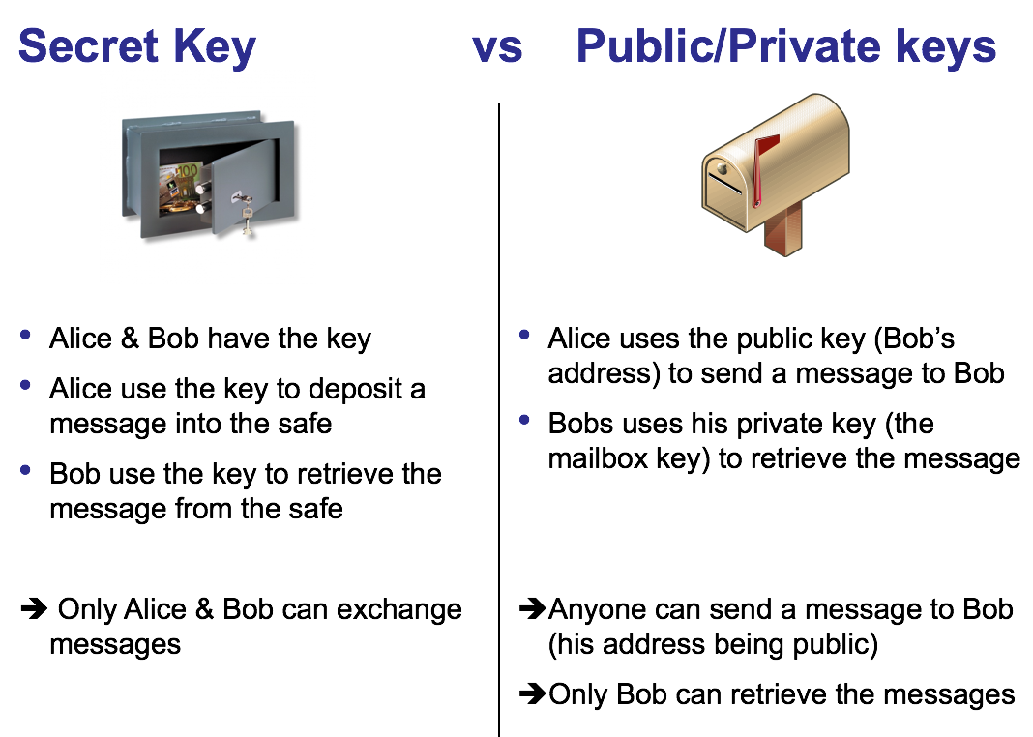
Symmetric vs. Asymmetric Encryption
Courtesy of L.Bouganim

Slide 22
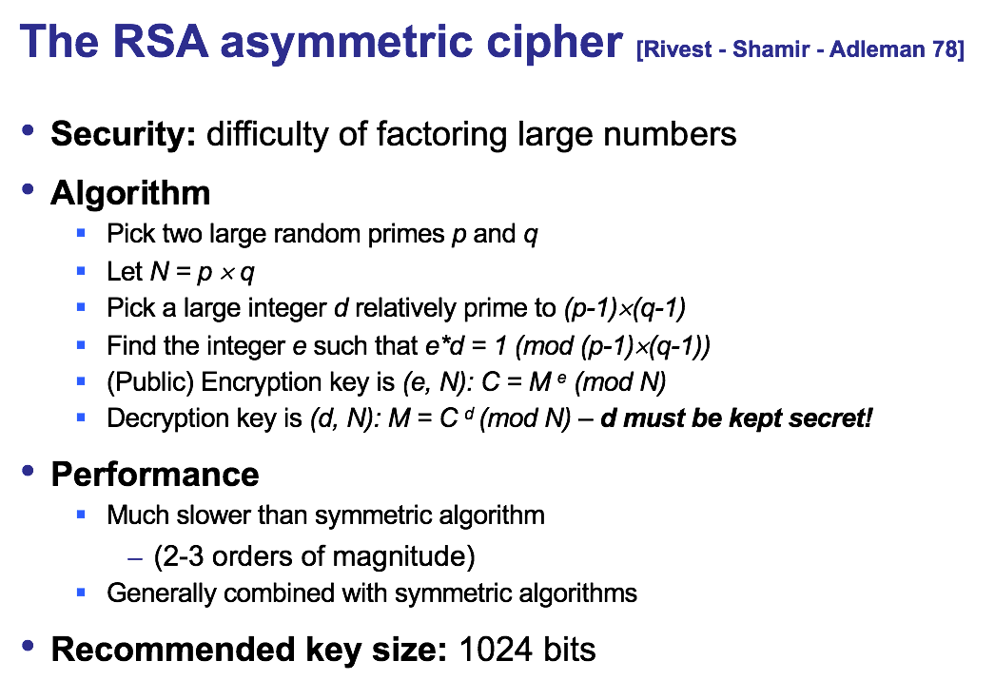
Asymmetric Encryption
Courtesy of L.Bouganim

Slide 23
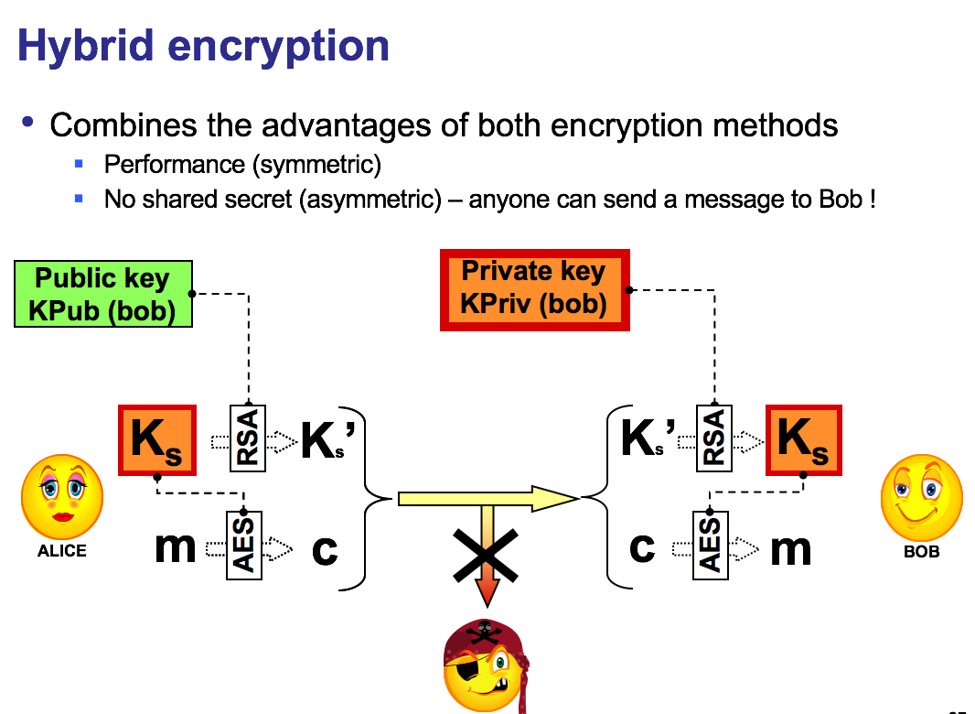
Hybrid Encryption

Slide 24
Combining cryptographic primitives
Goal: Resist to passive and active attacks
Passive attacks : threaten Confidentiality
Active attacks: threaten Integrity
Identity theft
Data alteration
Message forging
Replay attack
Repudiation
Destruction
Delays / reordering
1
5
4
3
2
6
2
2

Slide 25
(1) Confidentiality: Encryption alone
Ensures confidentiality – remind that
Symmetric encryption is efficient but needs a shared secret
Asymmetric encryption is slow but does not need a shared secret ➔need for a PKI however (Public Key Infrastructure)
Combining symmetric and asymmetric is a good option
Both must be carefully used
Mode of operation: ECB should not be used for messages with repetitive patterns (frequency analysis)
Only use known algorithms
Encryption does not ensure integrity
This is a common mistake (even encrypted data can be (randomly) altered)
Unless used in a very specific way
e.g., encrypting blocks with high redundancy to ensure integrity (e.g., a 128 bits block storing 64 bits of data, replicated)
This may lower the algorithm resistance to attacks

Slide 26
(2) Replay Attack
Problem:
Marvin copies the message and resends it to Bob
Solution:
Includes a unique timestamp (or sequence number) in the message.
The receiver keeps timestamps of recently received messages
He does not accept a duplicate
Remark:
Obviously, the timestamp integrity must be preserved (see point 4)
Remark (2):
Using sequence number may protect from reordering/destruction attacks.

Slide 27
(3) Message forging: Nonce
Problem:
Alice and Bob share a session key, K
Alice sends a message M1 to Bob and gets M2 back.
How can Alice be sure that M2 came from Bob and not from Marvin ?
Marvin might:
send a random string that Alice decrypts (using K) to another random string that looks like a correct response
replay an earlier message sent by Bob encrypted with K, that is a possible response (Alice is not a server that maintains a list of timestamps)
Solution: Include a nonce, N, in M1
A random string generated by Alice
Long enough so that Marvin cannot guess it
If M2 contains N+1 then it can only have been generated by Bob (since only Bob knows K) and it cannot be a replay

Slide 28
(4) Data alteration + Confidentiality
m
m
m
m
Encrypt
Hash
Encrypt
Hash
Encrypt
Encrypt
m ||
h
c || h
c
c
≈
Hash
Hash
Encrypt
c || h
h
Encrypt
Encrypt
c || h’
Symmetric encryption assumed
One construction is wrong
Others have different properties

Slide 29
Cryptographic hash functions
Goal: ensure data integrity
potentially combined with encryption (see after)
A hash function h must satisfy the following properties
maps an input x of arbitrary bit length, to an output h(x) of fixed bit length n.
h(x) must be easy to compute
A hash function h is a cryptographic hash functions if it satisfies (some of) the following properties
preimage resistance: given a hash value h, it is computationally infeasible to find any x, such that h(x) = h
2nd preimage resistance: given x and h, such that h(x) = h, it is computationally infeasible to find any second input y, such that h(y)=h(x)=h
collision resistance: it is computationally infeasible to find any two distinct inputs x and y such that h(x) = h(y)
Thus, a cryptographic hash function h ensures that any bit change in the input will impact the output.

Slide 30
Cryptographic hash functions (2)
Examples:
Message Digest 5 (MD5) [Riv92]
Secure Hash Algorithm 1 (SHA-1) [NIS95]
Process the input message by blocks of 512 bits
The result of the hash function is
160 bits for SHA-1
128 bits for MD5
SHA-1
Find a 2nd preimage requires 2¹⁶⁰ operations
Find a collision requires 2⁸⁰ operations
Non deprecated hash functions:
SHA-2, MD5 evolution
SHA-3 released in August 2015 based on Keccak

Slide 31
(5) Identity theft: Authentication-1
Is asymmetric encryption sufficient to ensure authentication ?
Alice and Bob have no shared secret but want to establish a secured communication.
They exchange their public keys and a session key encrypted with Alice public key
Is this protocol secure ?
Hi, Bob, I am Alice, here is my Public key, could you send me yours such that we can discuss securely ?
1
2
Hi Alice, I am Bob, here is my Public key and a session key encrypted with your Public Key
ALICE
3
Fine, Bob, here is my secret message encrypted with the session key….
BOB
4
Etc…

Slide 32
(5) Authentication-2: attacking the simple protocol
A “Man in the middle” attack can be conducted !!!
Marvin intercepts Alice’s message and exchange her public key with a generated public key (Marvin knows the corresponding private key)
Then, he intercepts Bob’s message, decrypt the session key, re-encrypt it with Alice’s public key (kept from 1st message) and exchange Bob’s public key with another generated public key
Alice and Bob does not notice anything and Marvin intercepts all messages, can even create fake message !
Need for a trusted party delivering public keys (PKI) or secret keys (e.g., Kerberos)
MARVIN
ALICE
BOB

Slide 33
(5) Authentication-3: trusted party & public keys
Alice has been previously registered by Trent, showing identity proofs and has sent her public key.
She received in return, a certificate containing her public key, certified by Trent.
Trent certificate is “well known” (certification hierarchy)
1 – Bobs asks Alice her certificate
2 – Alice sends her certificate to Bob, Bob checks its validity
3 – Bob sends Alice a session key encrypted with Alice public key
4 – Alice decrypts the session key and starts communicating with Bob
SSL is based on this scheme
(remark: Bob need not be registered)
TRENT
Registration
1
2
3
4
ALICE
BOB

Slide 34
(5) Authentication-4: trusted party & secret keys
Alice & Bob have been previously registered by Trent
During this registration, they exchanged a secret key only known by Trent/Alice (TA) or Trent/Bob (TB)
1 - Alice contacts Trent, sending a nonce for a communication with Bob
2 - Trent sends the nonce and the session key, both encrypted with TA. A ticket, including the session key encrypted TB key is also sent
3 - Alice checks the nonce, decrypts the session key, sends the Ticket to Bob
4 - Bob decrypts the Ticket, retrieve the session key, and starts communicating with Alice
KERBEROS is based on this scheme
TRENT
Registration
1
Registration
2
3
4
ALICE
BOB

Slide 35
(5) Authentication-5: Secret vs Public
Both need trusted third parties.
Secret (Kerberos)
Distributes symmetric keys
Operates on-line, when interaction takes place since it creates a new symmetric key for each session
Public (SSL, CA: Certification Authority)
Distributes public keys (certificates)
Operates off-line, prior to interaction since public key is fixed
Once certificate created, intervention by CA no longer required

Slide 36
(6) repudiation: Digital Signature-1
Digital Signatures can be used for
Proof of authorship
Non-repudiation by author
Guarantee of message integrity
Does not guarantee confidentiality (orthogonal)
If confidentiality is needed, encryption of the message must be used
Important for many Internet applications
Based on public key cryptography
Current systems use RSA algorithm
Basic idea:
Hash the message
Encrypt the hashing with the sender private key
Add to the message the sender public key and a certificate (for checking)

Slide 37
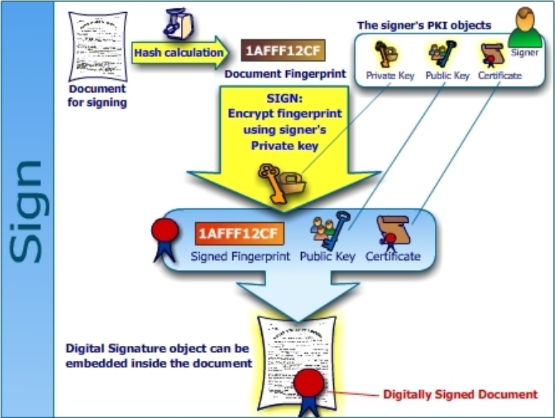
(6) Digital signature-2: Signing

Slide 38
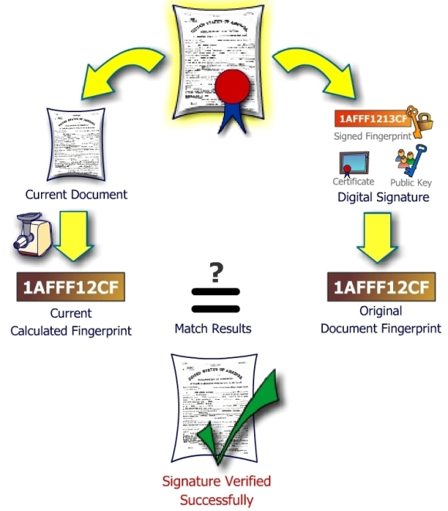
(6) Digital Signature-3: Verifying

Slide 39
Combining cryptographic primitives
Goal: Resist to passive and active attacks
Passive attacks : threaten Confidentiality
Active attacks: threaten Integrity
Identity theft
Data alteration
Message forging
Replay attack
Repudiation
Destruction
Delays / reordering
1
5
4
3
2
6
2
2

Slide 40
Outline
Core security concepts
Attacks and Counter-Measures
Cryptographic tools
Run-Time Security
Counter-measures in the cloud

Slide 41
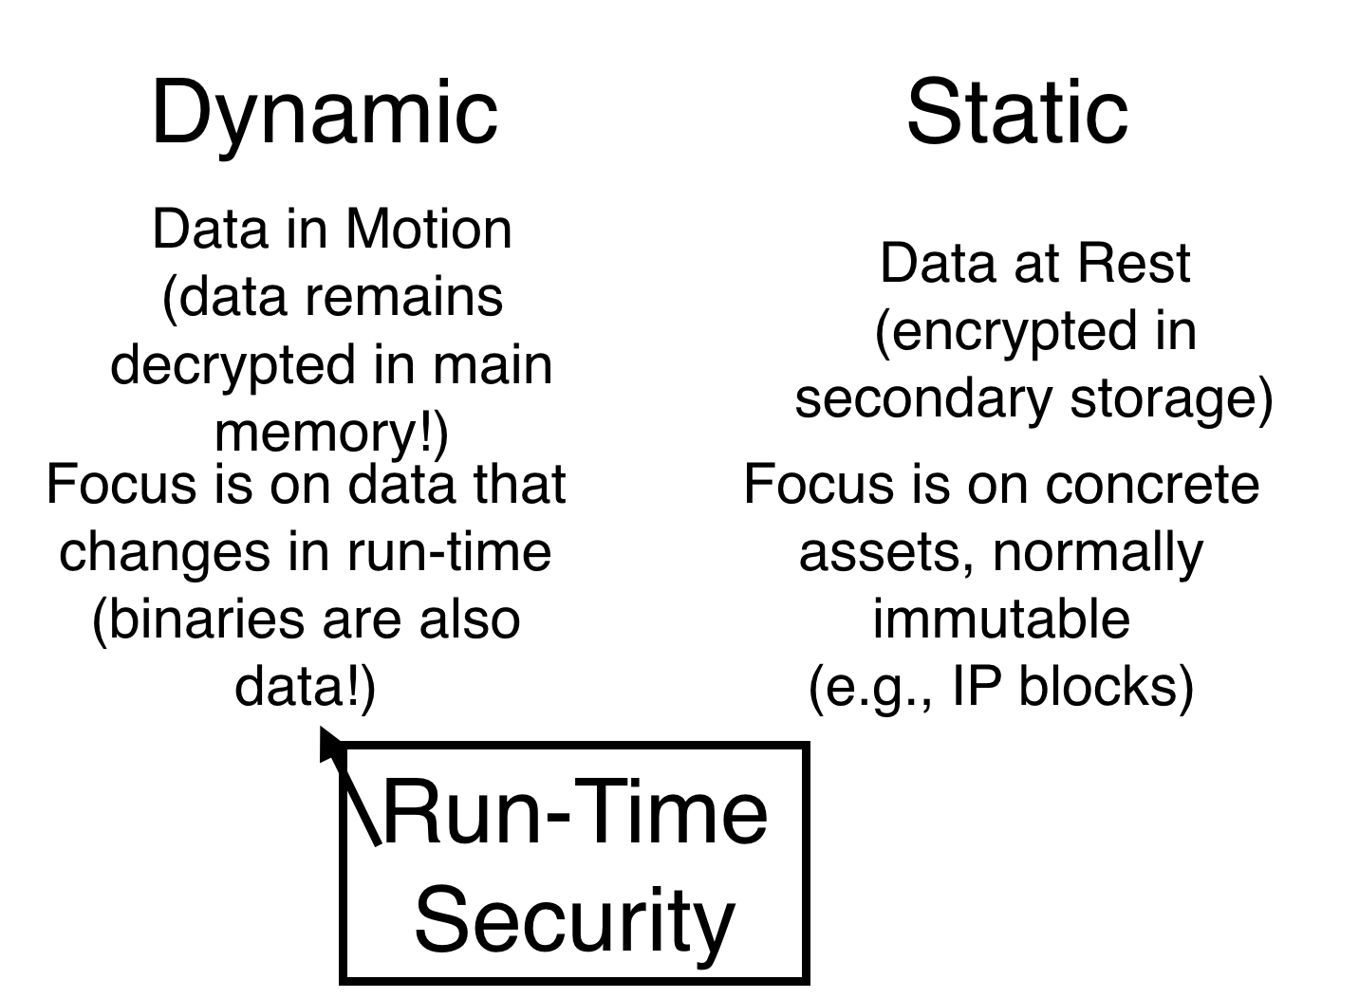
Run-Time Security

Slide 42
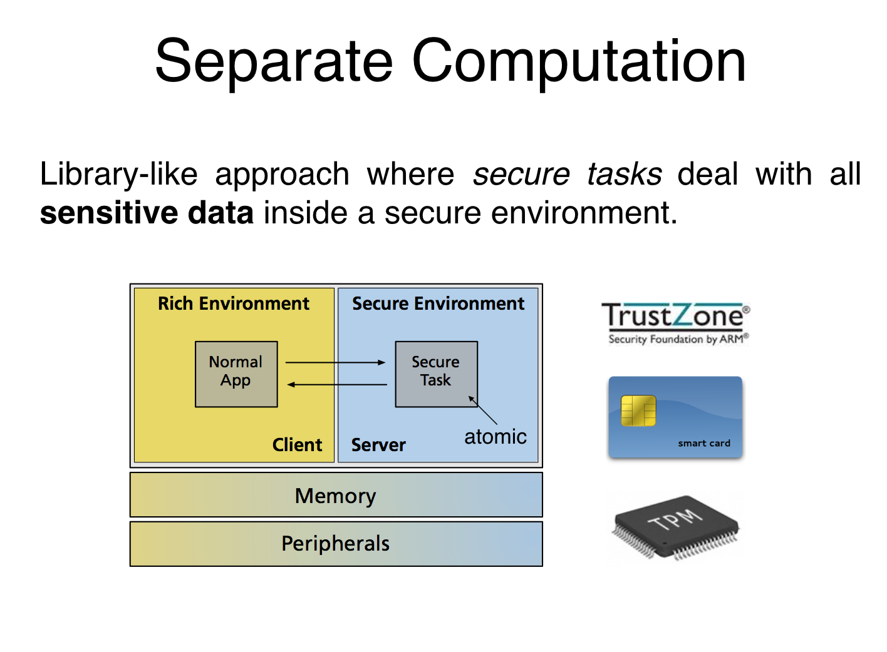
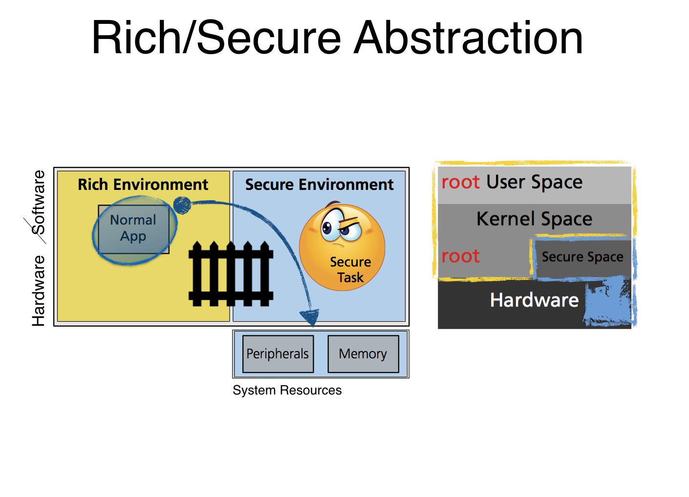
Run-Time Security

Slide 43
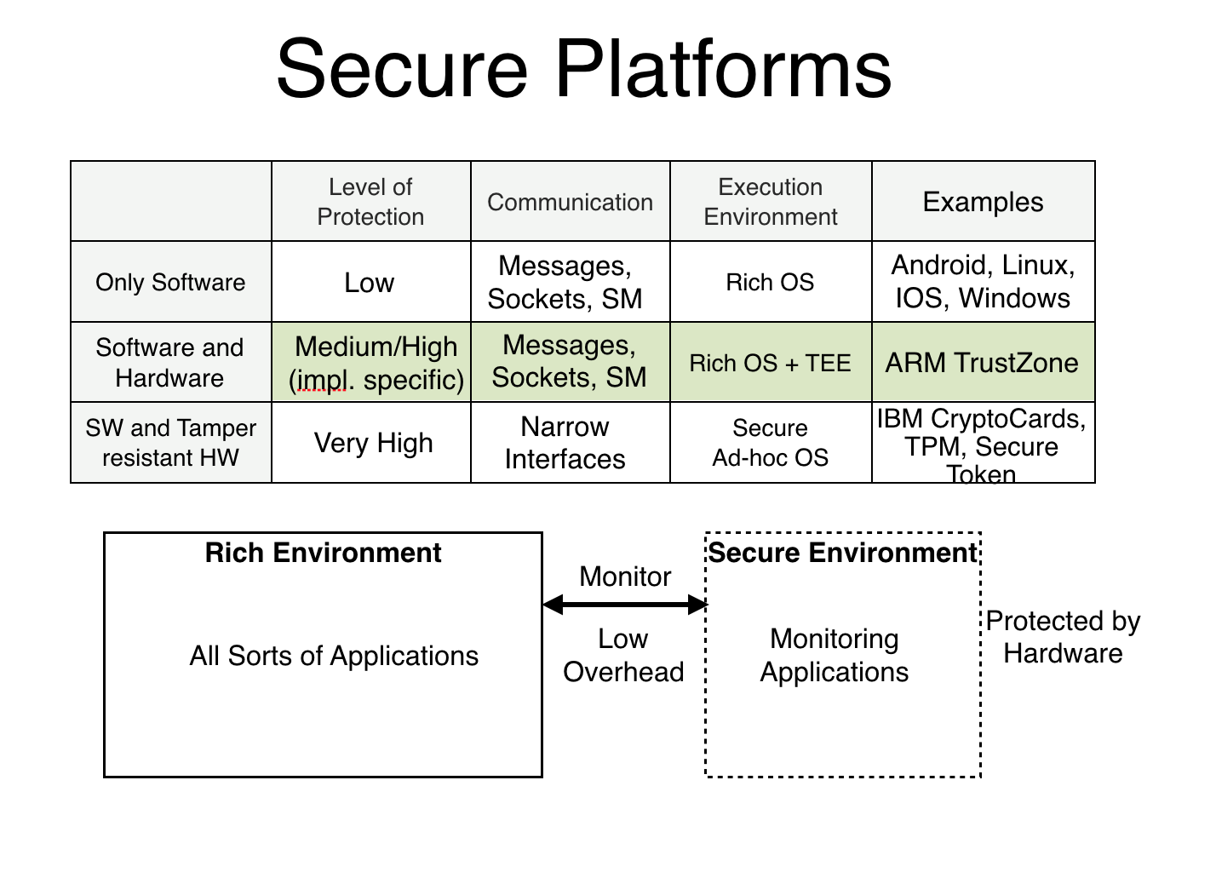
Hardware Protection

Slide 44
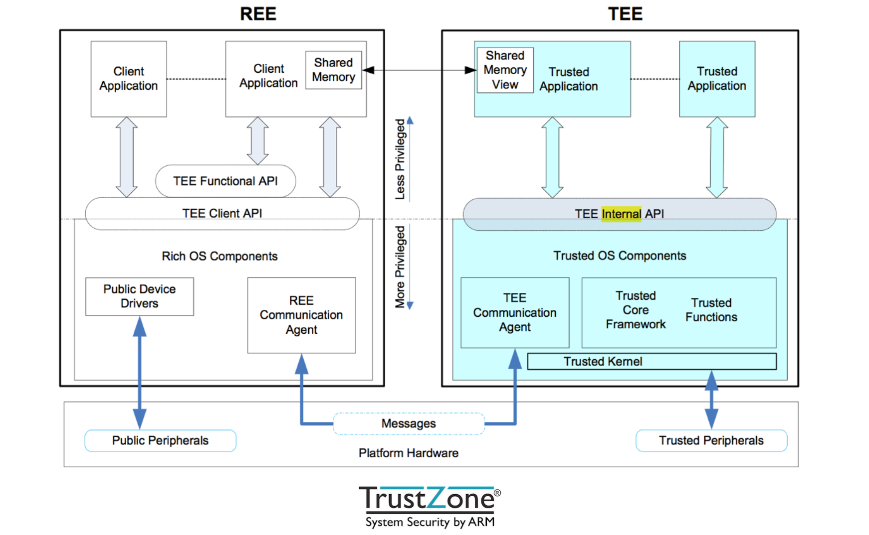
ARM Trustzone

Slide 45
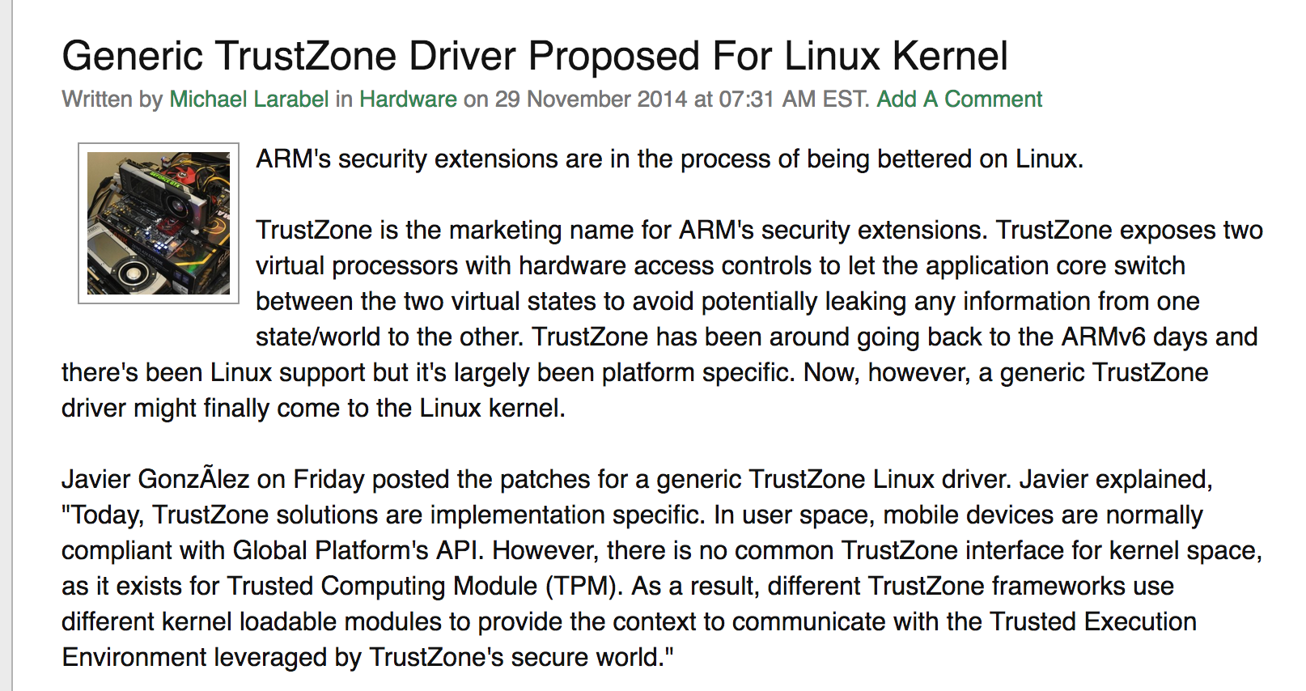
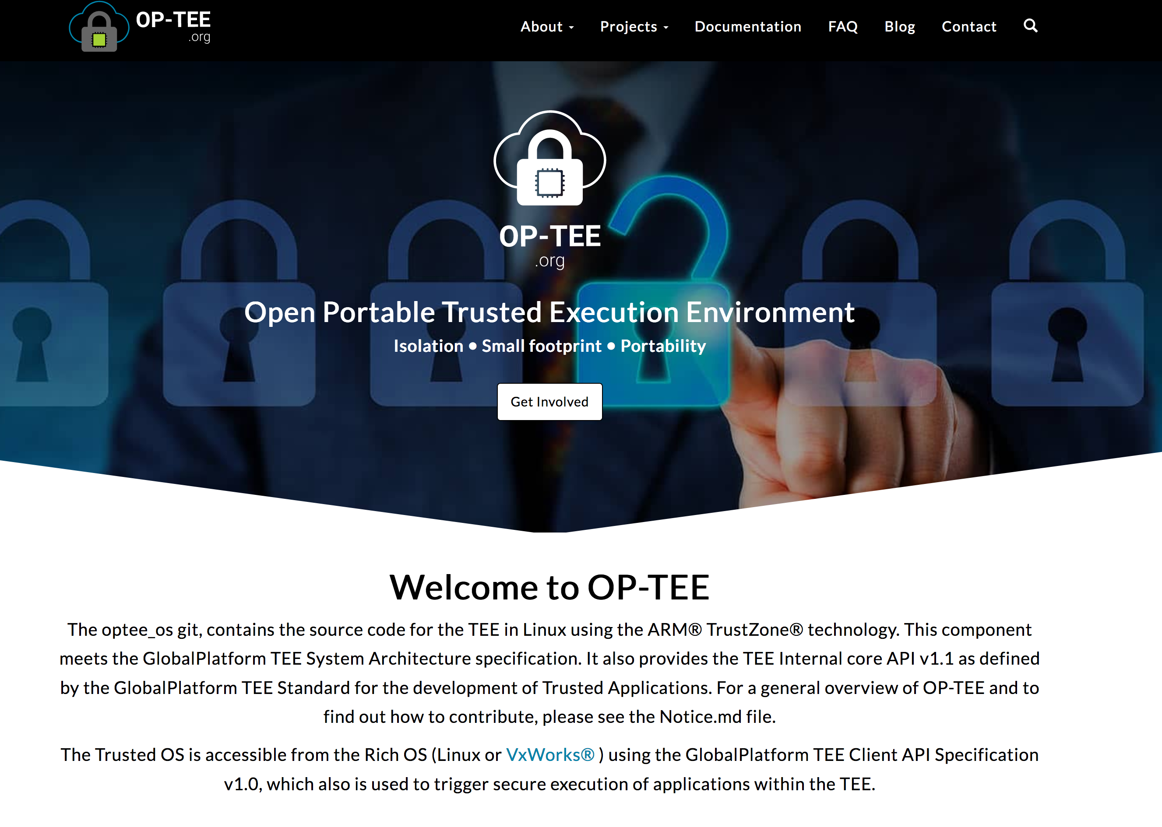
ARM Trustzone and Linux

Slide 46
Outline
Core security concepts
Attacks and Counter-Measures
Cryptographic tools
Run-Time Security
Counter-measures in the cloud

Slide 47
What is special in the Cloud?
How secure are managed services?
How to deal with migrated data?
How to deal with Hardware Protection?

Slide 48
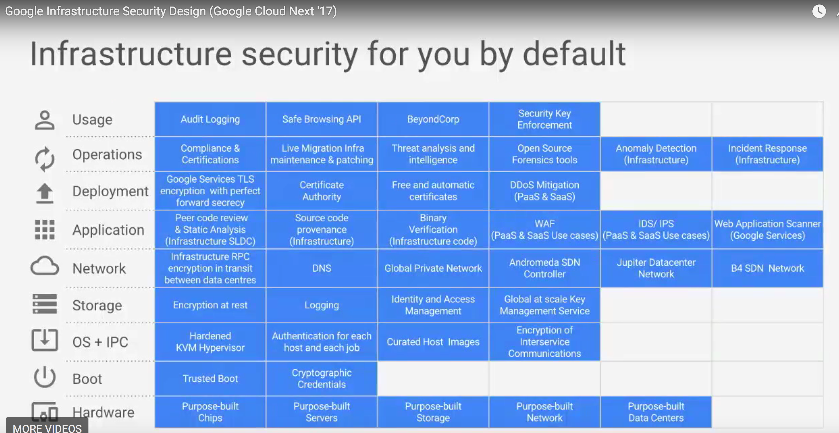
Securing Managed Services
https://cloud.google.com/security/

Slide 49
Dealing with Migrated Data
Who manages the keys? You or the Cloud Service Provider?
How does your Cloud Service Provider store/manage access to your keys?
How does the cloud service provider deal with multi-tenant issues?
After decommissioning of systems in the cloud, how to make sure that data is completely removed from systems.
https://cloud.google.com/kms/
https://cloud.google.com/security/security-design/

Slide 50
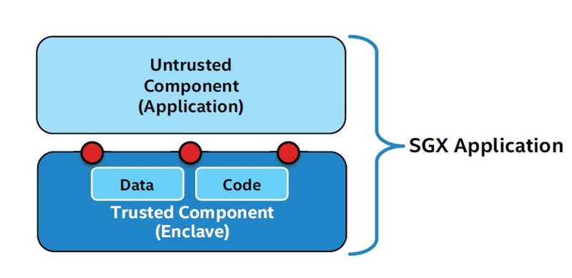
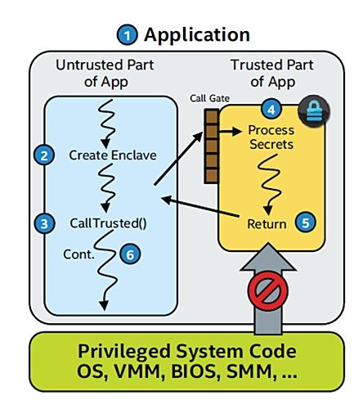
Hardware Protection in the Cloud
https://software.intel.com/en-us/sgx

Slide 51
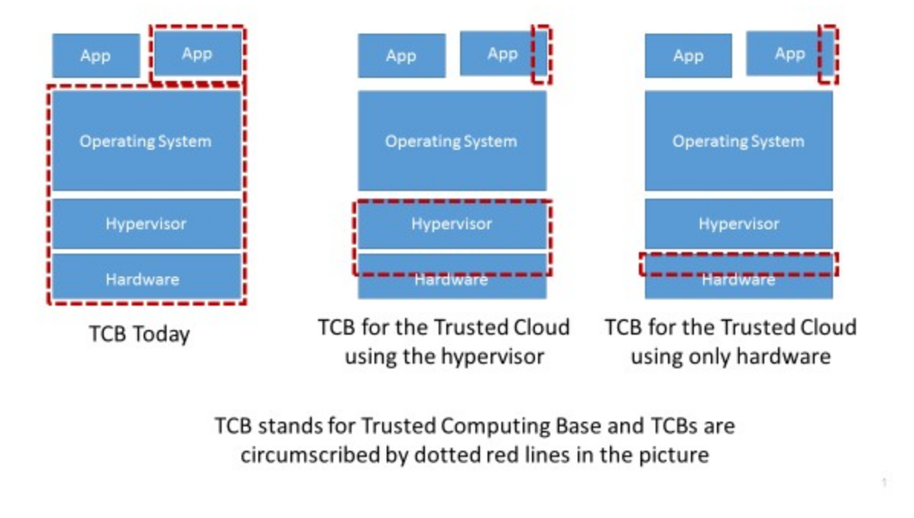
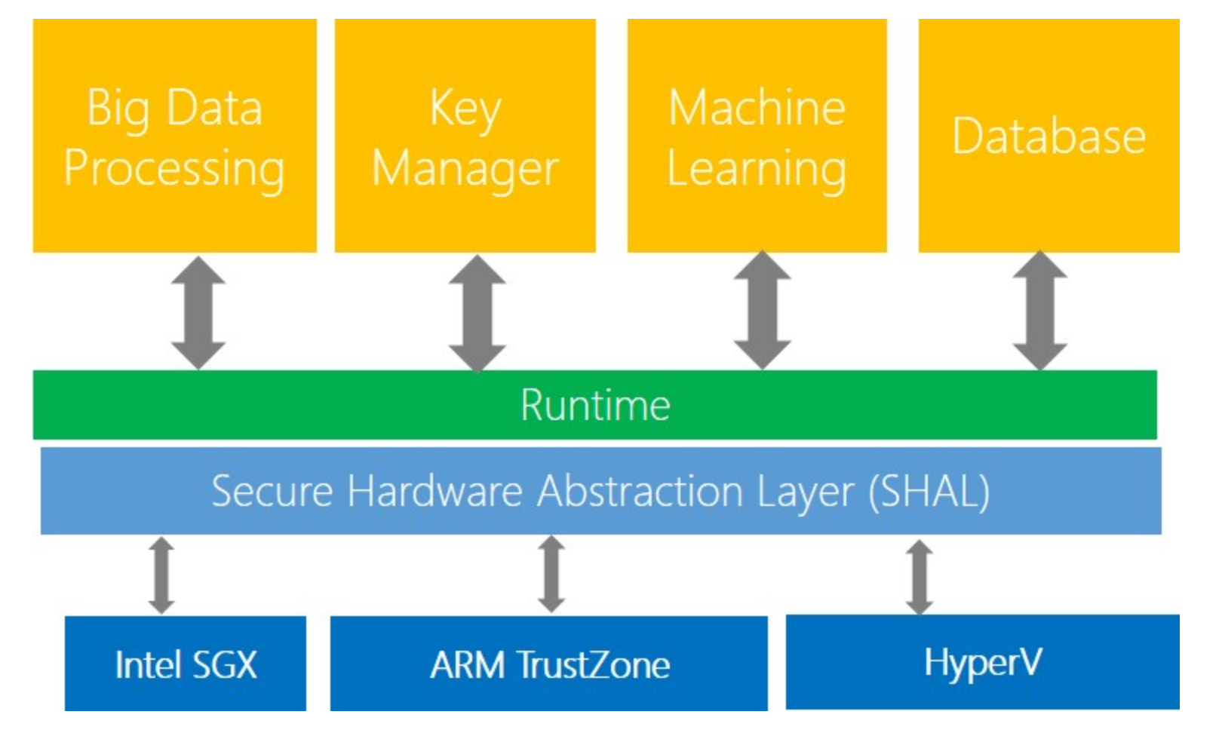
MSR Trusted Cloud

Slide 52
Take-Aways
Core security concepts: Confidentiality, Integrity, Availability.
In scalable-web systems, integrity and availability are increasingly important. So far, most efforts have focused on confidentiality.
Encryption and run-time security are key. There is support for both on cloud-based platforms. Key design decisions about (i) key management and (ii) Trusted Code Base.

